Slide 1


Math Project Work
Name:- Arnab Chatterjee
Class :- XI-Sc
Sub:- Math
Topic:- Trigonometry

Slide 2





Trigonometry
Trigonometry is a branch of mathematics that studies relationships between side, lengths and angle of a triangle.
The field emerged in the Hellenistic world during the 3rd century BC from applications of geometry to astronomical studies.
The Greeks focused on the calculation of chords, while mathematicians in India created the earliest-known tables of values for trigonometric ratios (also called trigonometric functions) such as sine.

Slide 3

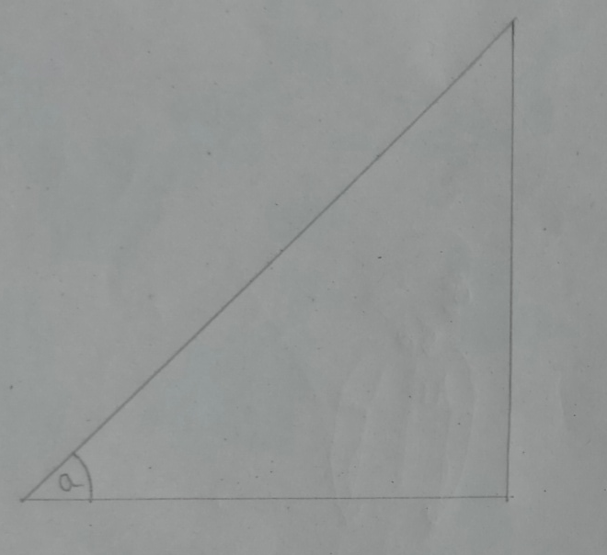
Trigonometric Ratios
So, here a right angled triangle drawn in a page.
Let’s simplify the figure.

Slide 4
Trigonometric Ratios
So, here the simplified figure with labeling and with base angle O.
The trigonometric ratios are:-
Hypotenuse
sin o = Perpendicular/Hypotenuse
Perpendicular
cos o = Base/Hypotenuse
tan o = Perpendicular/Base
Base
cosec o = 1/sin o
sec o = 1/cos o
cot o = 1/tan o

Slide 5



But what can be the practical utility of trigonometry?

Slide 6
Now consider a situation : If a boy standing in front of a tree and he knows the distance the tree and him and also the angle of sight. He wants to find the height of the tree.
Here , trigonometry plays a big role.

Slide 7
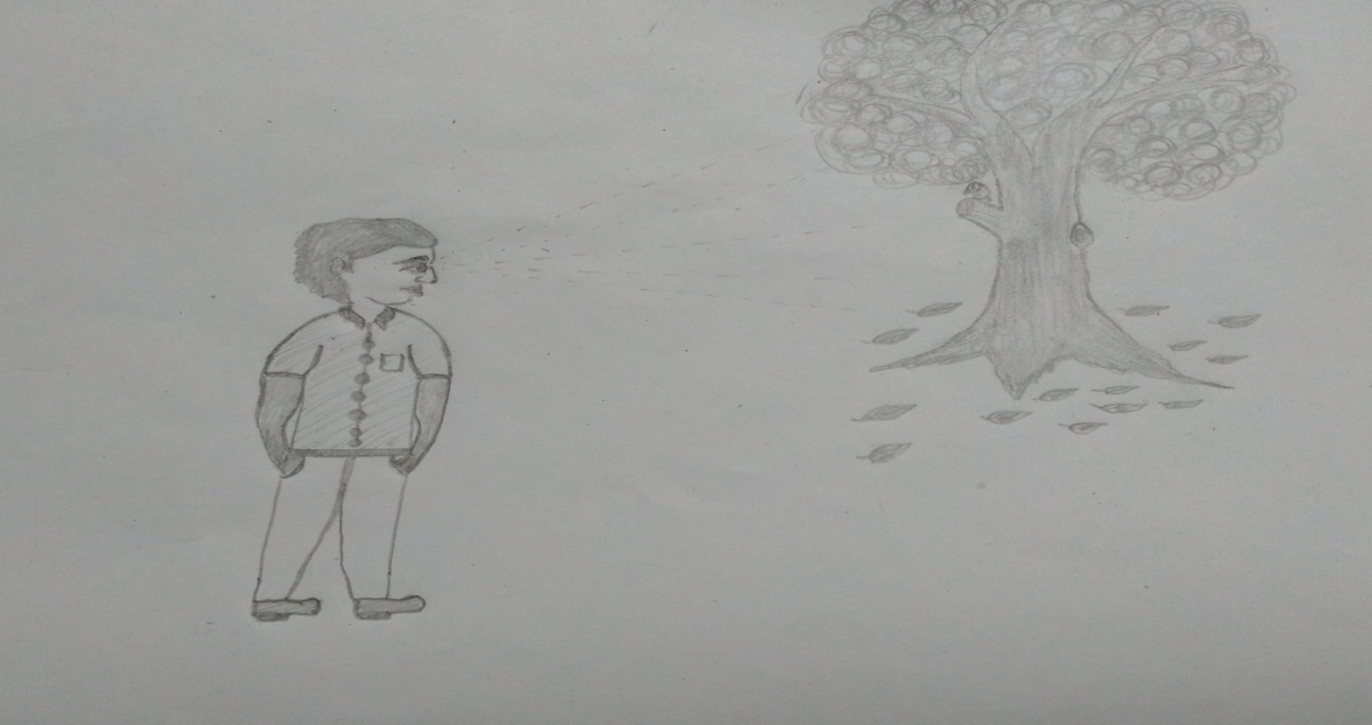
C
A
B
Here a boy is watching a tree.
If we simply the figure it will be much more clear. Lets , see the line diagram.

Slide 8
C
A
B
AB is the distance between the tree and the boy and the angle of sight be O
BC is the height of the tree .
Now, tan o = BC/AB
BC= AB x tan o
Hence, height of tree is (AB x tanO)

Slide 9


Link With Ladakh
Left side we have Buldozes Mountain of China.
Right side we have Ladakh Mountains.
We can find the height of the mountains by trigonometry.
Let, angle of sight from base of Buldozes to Ladakh be a.
Hence, Height of Ladakh Mountain= tan a x Distance between them.

Slide 10
Thank You
Prepared By:-
Arnab Chatterjee
Class-XI-SC

